Slide 1
ECE 453
Wireless Communication Systems
Oscillators
Jose E. Schutt-Aine
Electrical & Computer Engineering
University of Illinois
jesa@Illinois.edu

Slide 2
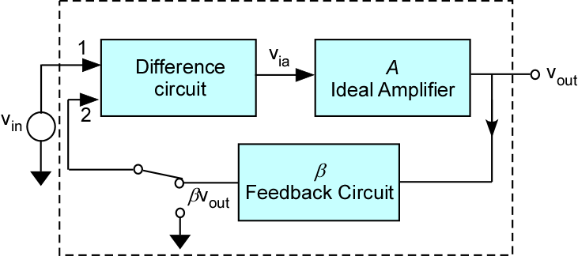
Feedback – Basic Concept

Slide 3
Feedback and Frequency Dependence
The closed-loop transfer function is a function of frequency
The manner in which the loop gain varies with frequency determines the stability or instability of the feedback amplifier
The frequency at which the phase of the transfer function is equal to 180º will be unstable if the magnitude is greater than unity

Slide 4
Feedback and Stability
When loop gain A(jω)β(jω) has 180º phase, we have positive feedback

Slide 5
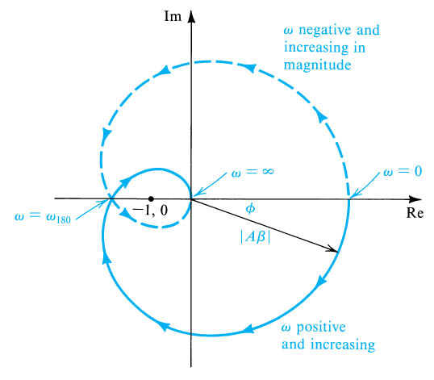
Nyquist Plot
Radial distance is |Aβ|
Angle is phase of φ
Intersects negative real axis at ω₁₈₀

Slide 6
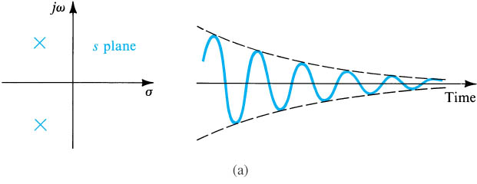
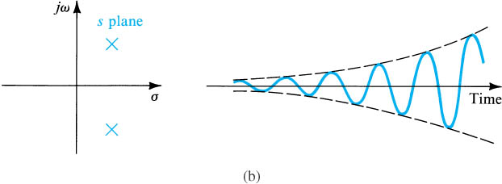
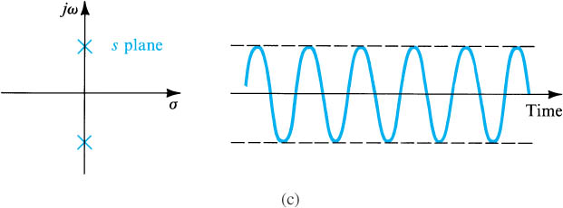
Stability and Pole Location

Slide 7
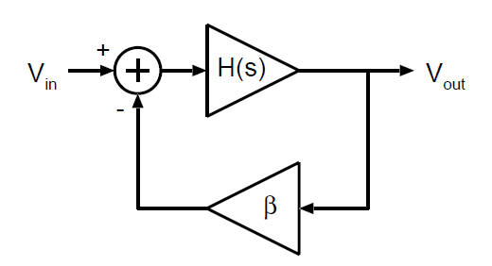
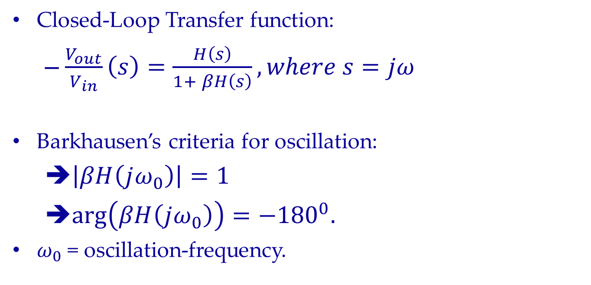
Oscillator
Closed-Loop Transfer function:
$\frac{V_{out}}{V_{in}}\left(s\right)=\frac{H\left(s\right)}{1+ βH\left(s\right)}, where s=jω$
Barkhausen’s criteria for oscillation:
➔$\left|βH\left(jω_{0}\right)\right|=1$
➔$\arg\left(βH\left(jω_{0}\right)\right)=−{180}^{0}.$
$ω_{0}$ = oscillation-frequency.

Slide 8
Oscillator Topologies
Common-base topology is usually preferred because
Feedback within transistor is minimized (low Miller)
External feedback is dominant
Current gain has little phase shift and is constant with f
Oscillator built around 2 major requirements:
Oscillation frequency f_{o}
Power P_{o} that must be delivered to a load
Other criteria
Efficiency
Spectral purity
Frequency stability

Slide 9
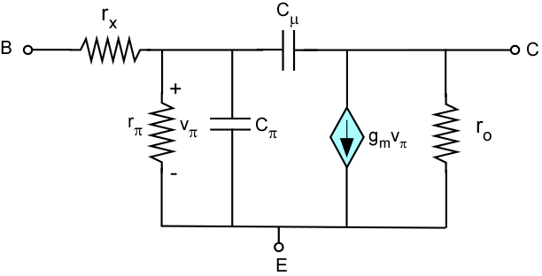
BJT – High-Frequency Model

Slide 10
Common-Collector Colpitts
Minimize circuit dependence on transistor internal parameters
Choose

Slide 11
Incremental Model
For Oscillation, we want Z_{left} = -Z_{right}

Slide 12
Oscillation Criteria
Condition gives
Term in ω⁻⁴ can be neglected. This gives
Gives transconductance g_{ms} to set net resistance to zero

Slide 13
Oscillation Conditions
g_{ms} is the transconductance needed to support steady-state oscillations
If g_{m} << ωC₁β and assuming that β is large,
In terms of the inductor quality factor Q_{L}

Slide 14
CC-Colpitts - Observation
To implement tunable oscillator
Use variable capacitor in parallel or is series with inductor
To extract power from oscillator
Place resistance in shunt with inductor
Account for loading effect in analysis and design
Oscillation amplitude builds up and v_{be} increases
Transistor moves out of linear range and operation becomes nonlinear. Transconductance decreases.
When transconductance reaches g_{ms}, steady state operation is achieved.

Slide 15
Common-Base Colpitts
C_{f} : tuning capacitor
C₁ & C₂: feedback ratio
RFC: RF choke to prevent power dissipation in R_{E}
R_{P} is equivalent resistance of coil L_{t}.
DEFINITIONS

Slide 16
CB-Colpitts - Incremental Model
Setting the determinant to zero provides the criterion for the onset of oscillation.

Slide 17
CB-Colpitts - Oscillation Conditions
Setting the determinant to zero gives.
Defining
and
we get a complex conjugate pair of roots. This leads to 2 equations for real and imaginary parts that must be equal to zero separately

Slide 18
CB-Colpitts - Oscillation Conditions
From the equation for the imaginary part, we get
or
First term should predominate

Slide 19
CB-Colpitts - Oscillation Conditions
In that case
which leads to
Circuit oscillates at frequency determined by L_{t} and equivalent capacitance.

Slide 20
CB-Colpitts - Oscillation Conditions
The solution of the real part using ω = ω_{ο} gives
For oscillations to start, α of the transistor should be greater than α_{min}.

Slide 21
Crystal Oscillator
Quartz exhibits piezoelectric effect
Reciprocal relationship between mechanical deformation and appearance of electrical potential
Deforming crystal produces voltage
Applying voltage produces deformation
When applied voltage is sinusoidal
Mechanical oscillations that exhibit resonances at multiple frequencies
Extremely high Q that can reach 10⁵ and 10⁶
Do not work above 250 MHz

Slide 22
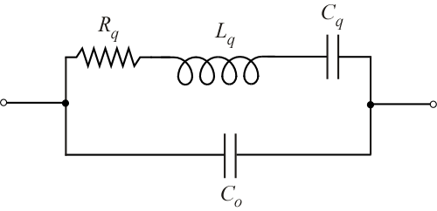
Crystal Resonator - Circuit Model
R_{q}, L_{q} and C_{q} describe mechanical resonance behavior C₀ is capacitance due to external contacting
- L_{q} ,C_{q}, R_{q} describe mechanical resonance
- C₀ is due to external contacting

Slide 23
Crystal Resonance Frequencies
Admittance from terminals is
Resonance condition is expressed by

Slide 24
Crystal Resonance Frequencies
Series resonance frequency
Parallel resonance frequency
where

Slide 25
Crystal Oscillator - Example
Crystal is characterized by L_{q} = 0.1H, R_{q} = 25Ω, C_{q} = 0.3pF, and C₀ = 1 pF. Find series and parallel resonance frequencies and compare them against the susceptance formula.

Slide 26
Voltage Controlled Oscillator
Varactor diode exhibits large change in capacitance in response to an applied bias voltage
Varactor diode

Slide 27
Voltage Controlled Oscillator

Slide 28
Voltage Controlled Oscillator
Finding input impedance
Re-write as (assuming h₁₁>>X_{C1} and β+1 ~ β )
Using g_{m} = β/h₁₁
Negative resistance

Slide 29
VCO – Resonance Frequency
Resonance frequency follows from condition:
where
which gives
Combined resistance of varactor diode must be equal to or less than |R_{IN}| to create sustained oscillations
and

Slide 30
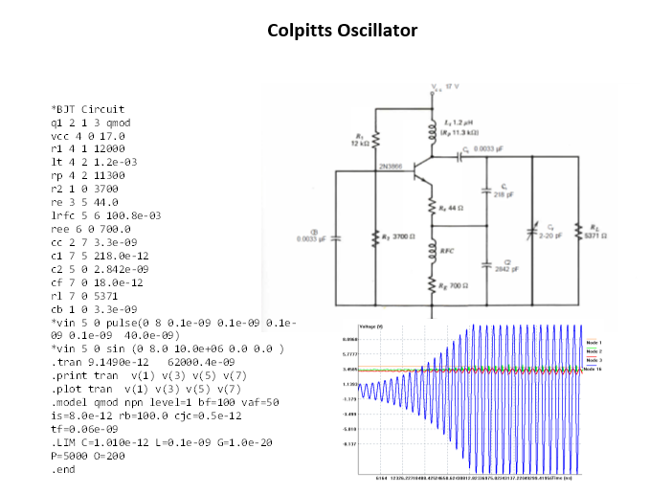
Simulation - Colpitts Oscillator

Slide 31
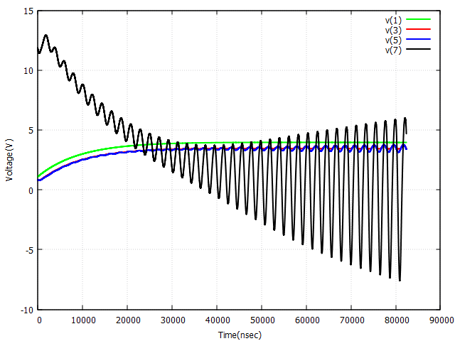
Simulation - Colpitts Oscillator

Slide 32
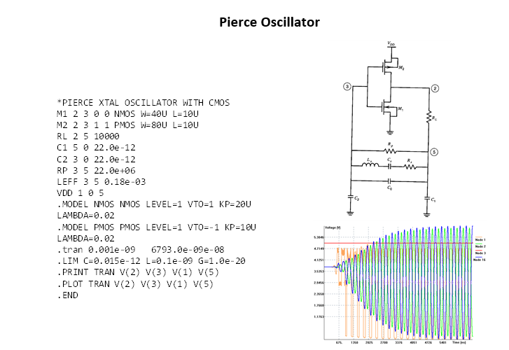
Simulation - Pierce Oscillator

Slide 33
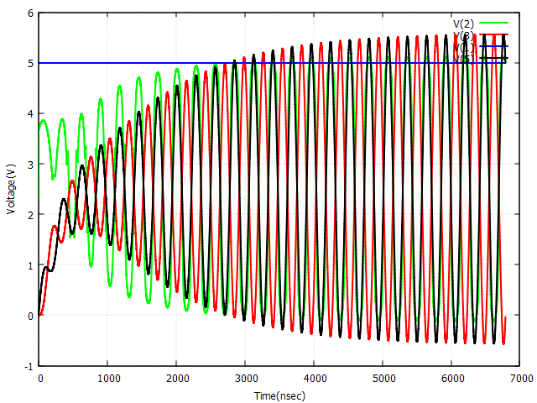
Simulation - Pierce Oscillator

Slide 34
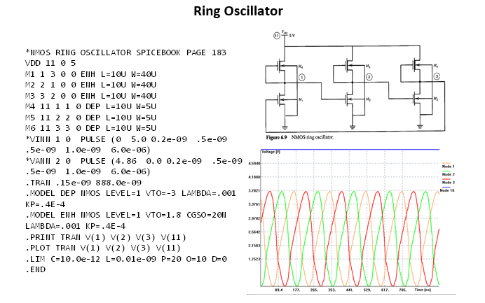
Simulation - Ring Oscillator

